Slide 1
Deep Learning

Slide 2
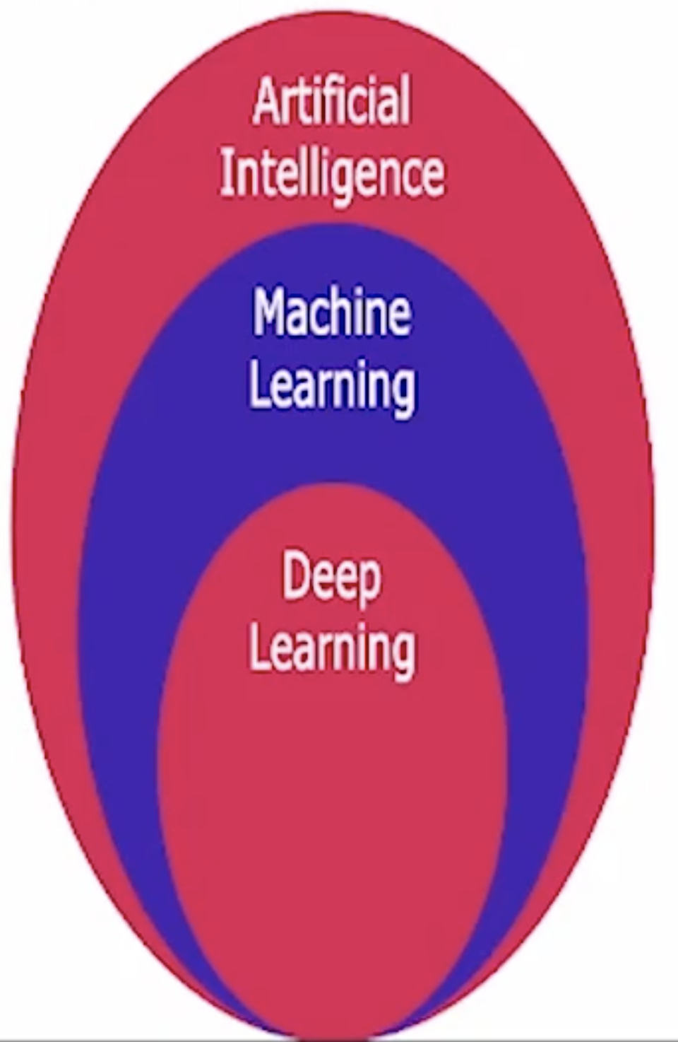
What is AI?
AI: Attempt to imitate the cognitive abilities or behavioral
characteristics of humans or any other living entity
Machine learning: Learns with data to figure out handling situations
over time, maybe with a feedback mechanism to increase accuracy
of predictions or give better decisions
Deep Learning: Technique to perform machine learning inspired
by our brain.
ML and DL learns patterns in data
Deep learning is a sub park of machine learning which operates in
complex neural networks with multiple layers to analyze more
intricate patterns and relationships.

Slide 3
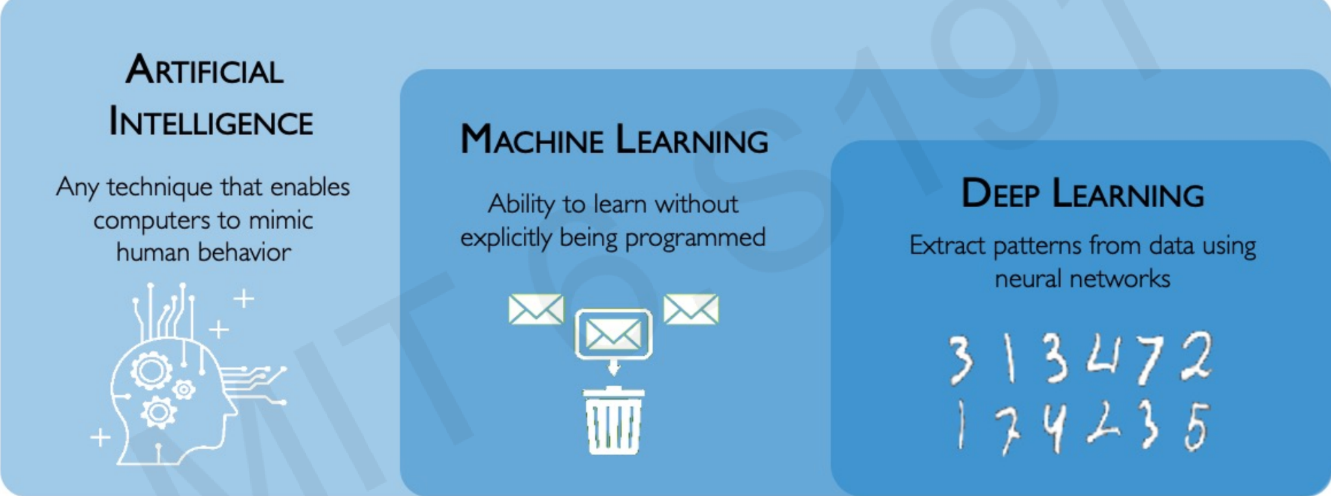
AI vs ML vs DL

Slide 4
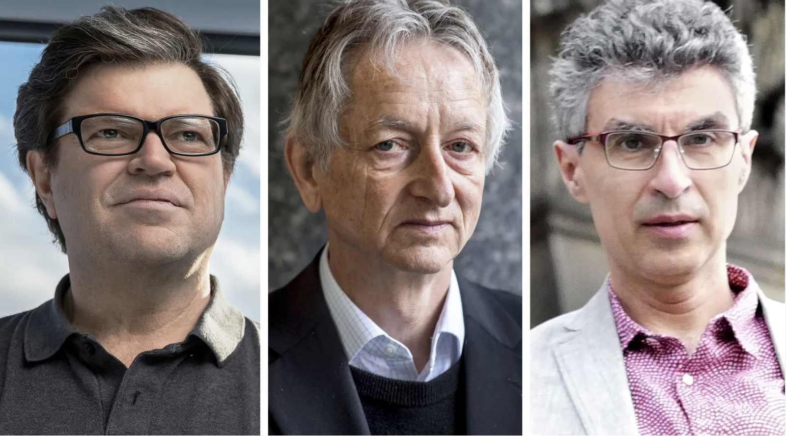
Experts of AI
`Yann LeCun
Geoffrey Hinton
Yoshua Bengio
Notes:
A.M. Turing Award, “the Nobel Prize of Computing”
Geoffrey Hinton: he sees artificial intelligence as a relatively imminent existential threat”.
There are not enough guardrails to control the technology.

Slide 5
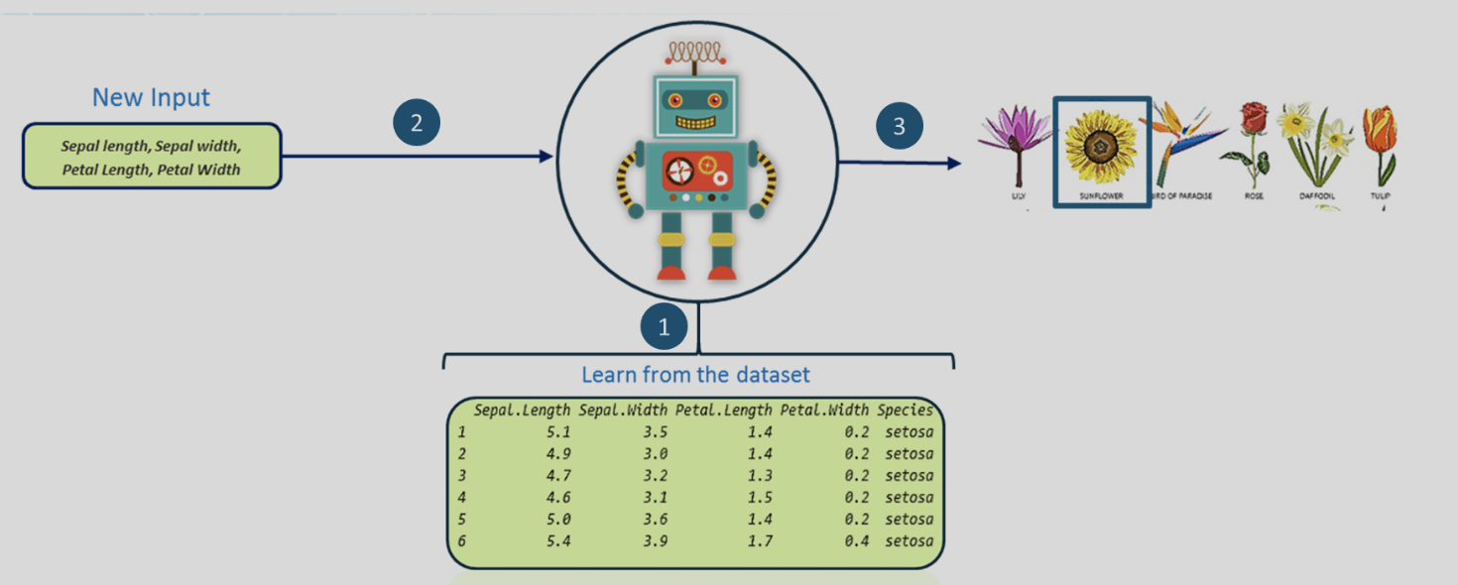
Limitation of Machine Learning and rise of Deep Learning
Provide specific features to the machine
Get the data, do image processing stuffs
In the Flower dataset, measure each Petal width, sepal width, petal length, and sepal length of each flower and make observation from each data measured.

Slide 6
Deep Learning
Deep learning Modes are Capable of Focus on the right features themselves, requiring little guidance from programmer.
Deep Learning = Machine Learning + Representation Learning
Representation Learning: Method to fed raw data to machine and automatically discover representation needed for detection/ classification (Deng & Yu, 2014)

Slide 7
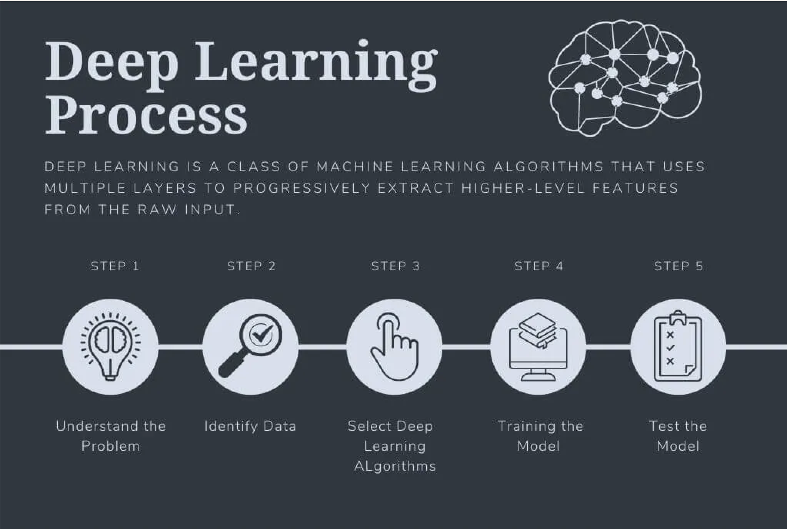
Deep Learning Process

Slide 8
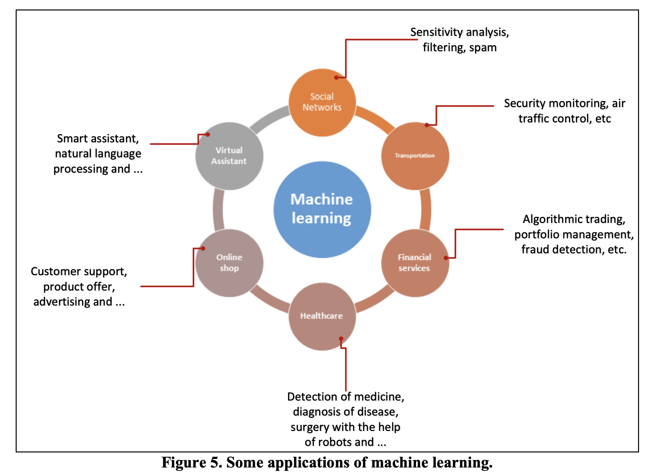
Applications of deep learning

Slide 9
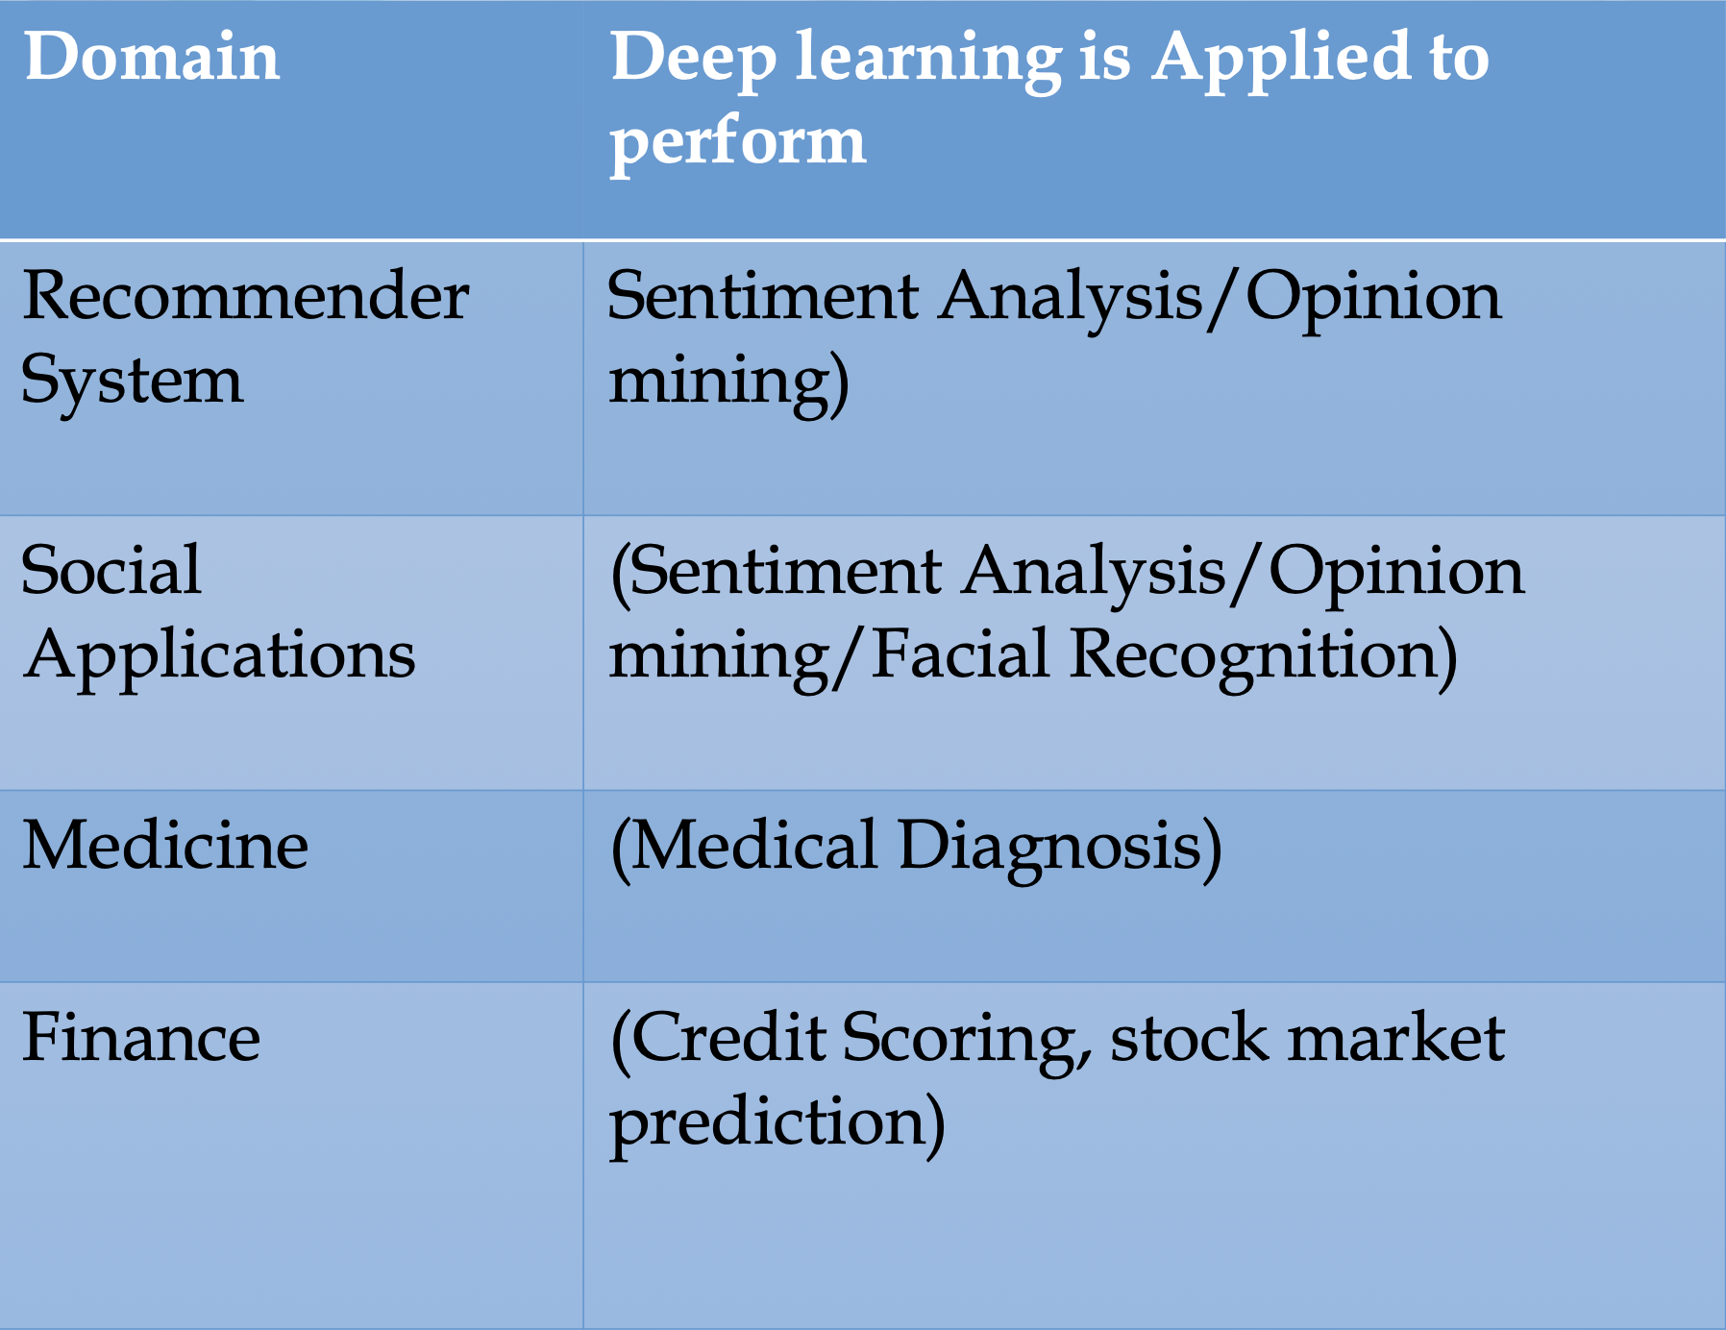
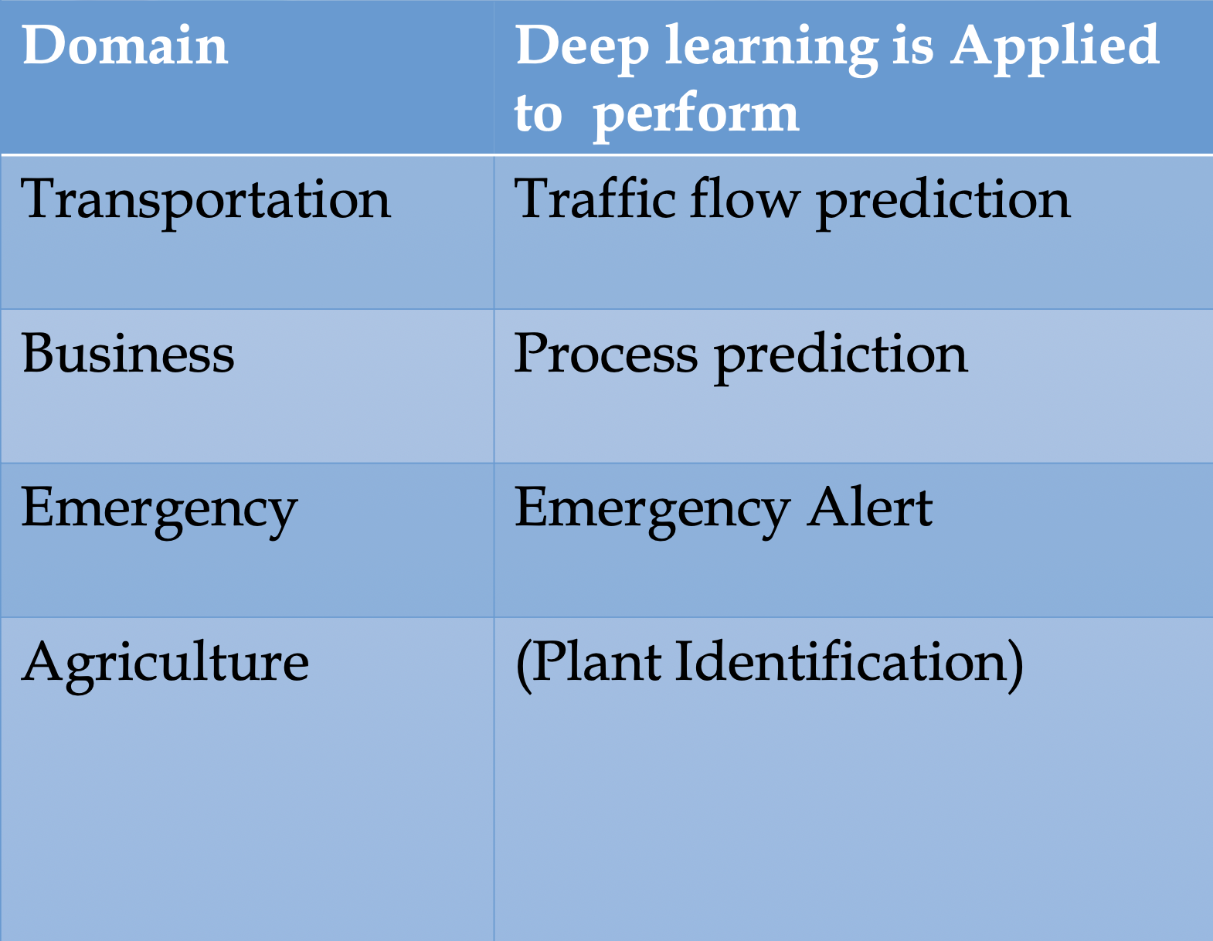
Applications of deep learning

Slide 10
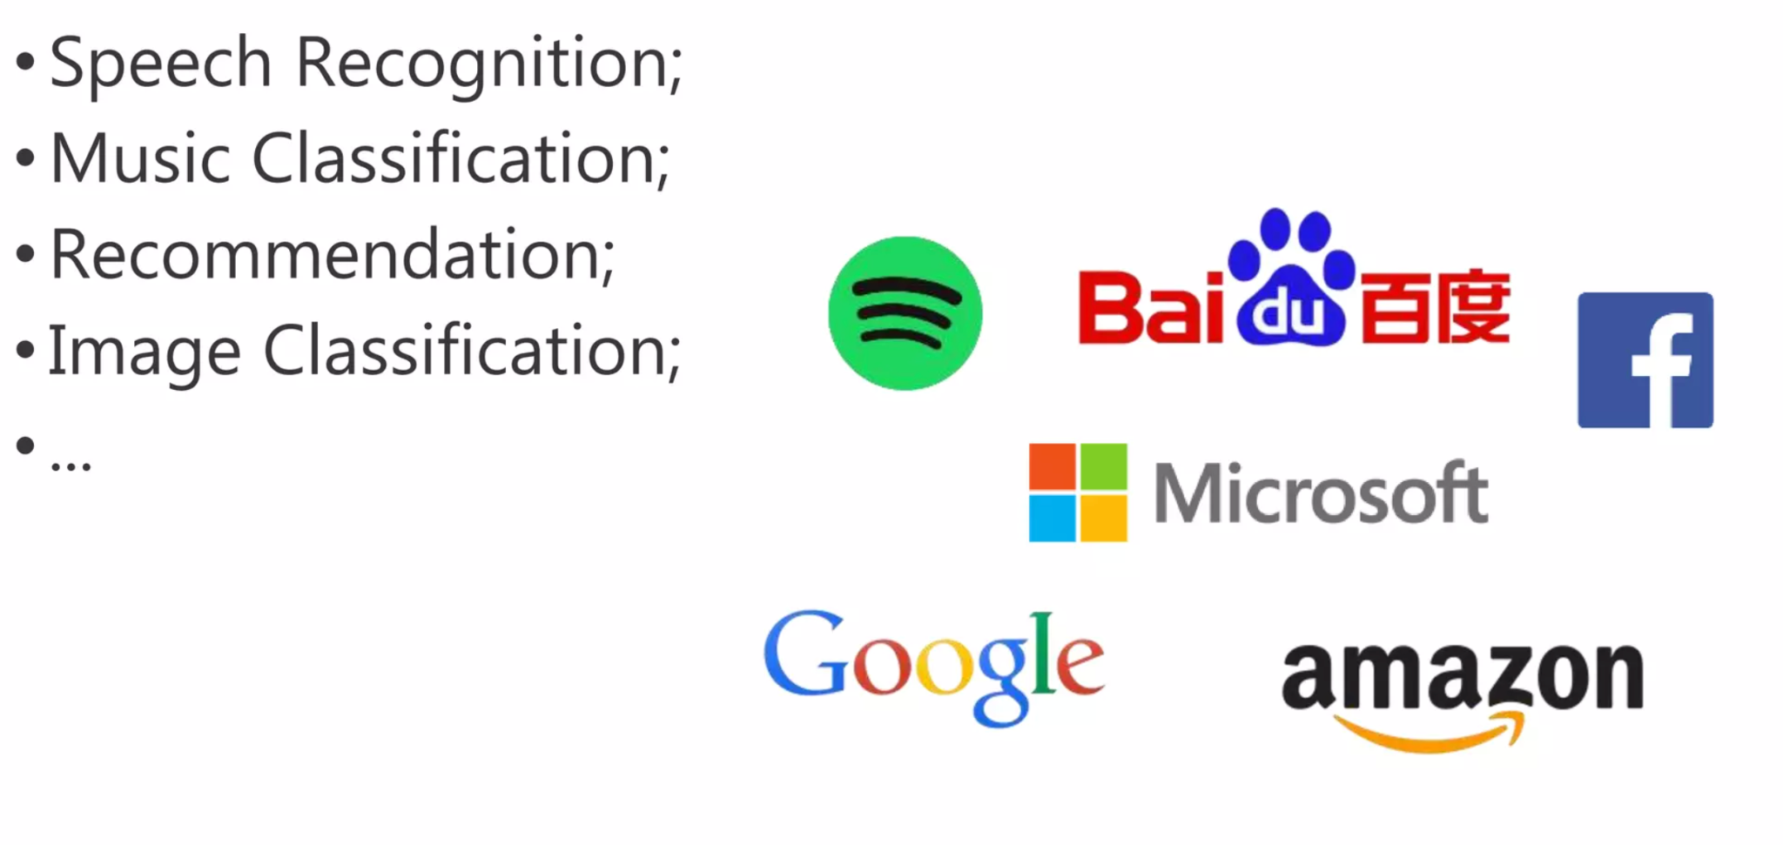
In real world places where it is being used in day to day life

Slide 11
Getting into Science of Deep Learning

Slide 12
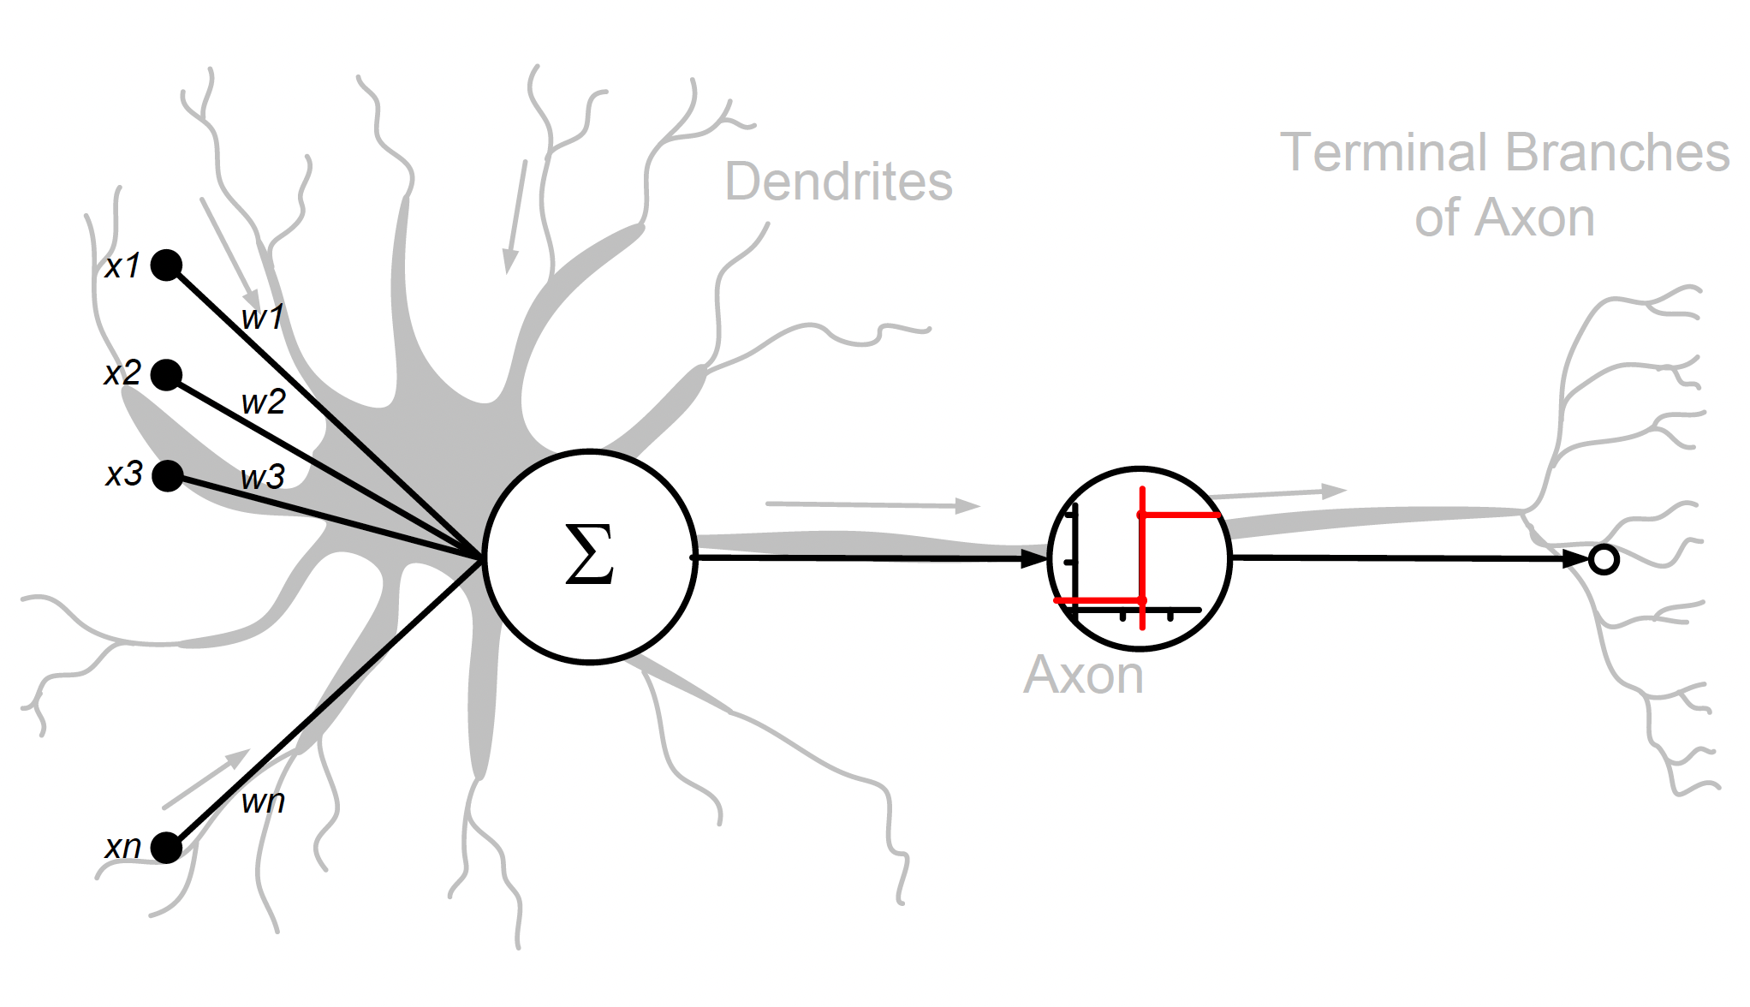
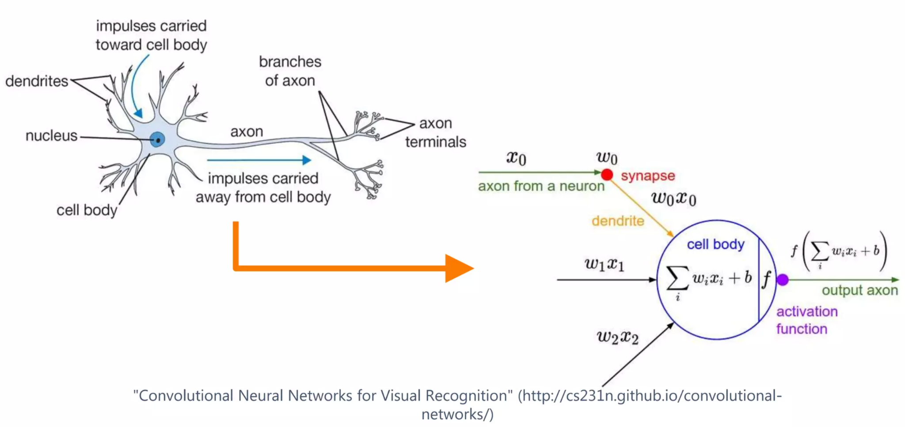
Human Brain and a Perceptron
Notes:
weights used to calculate a weighted sum of the inputs.

Slide 13
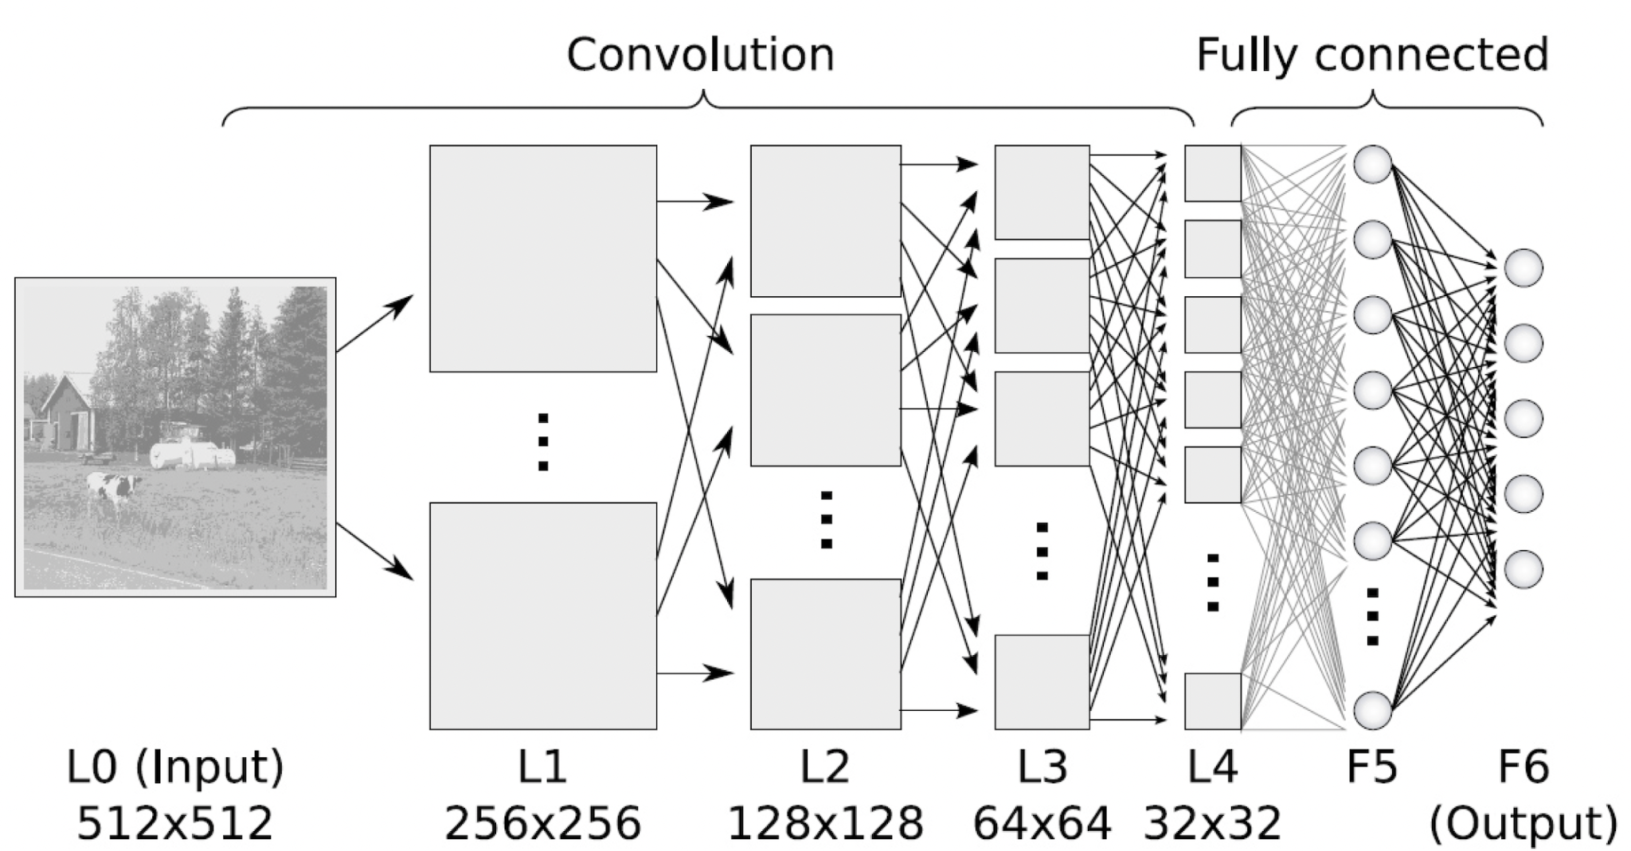
Deep neural network

Slide 14

Which number is this?

Slide 15

How do you differentiate between 9 and 2?

Slide 16
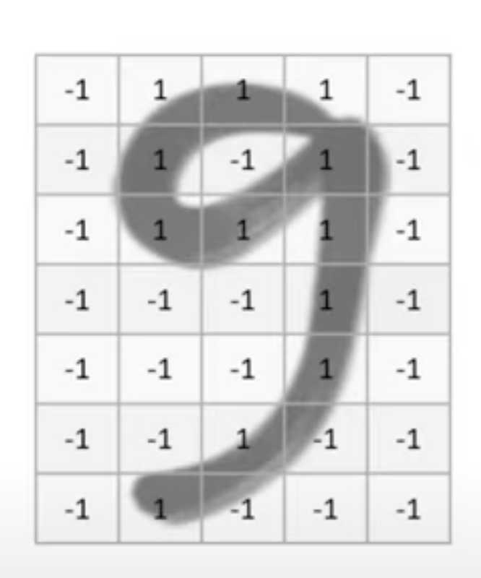
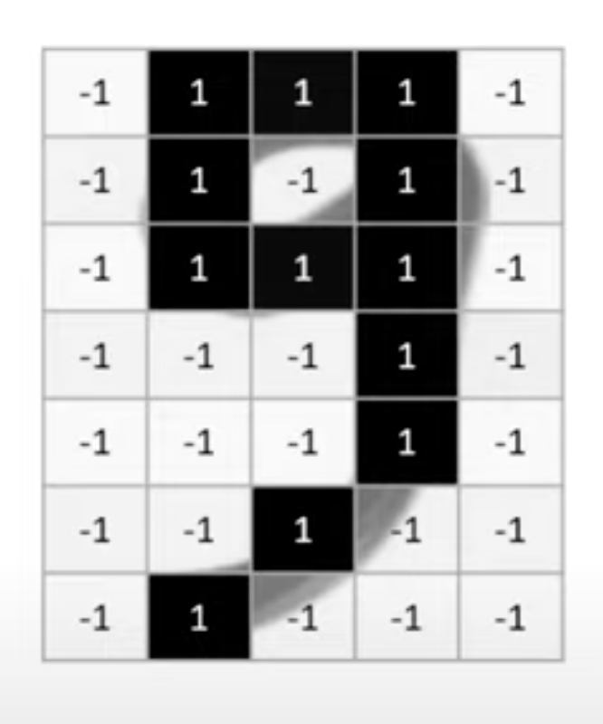
What is happening here?

Slide 17
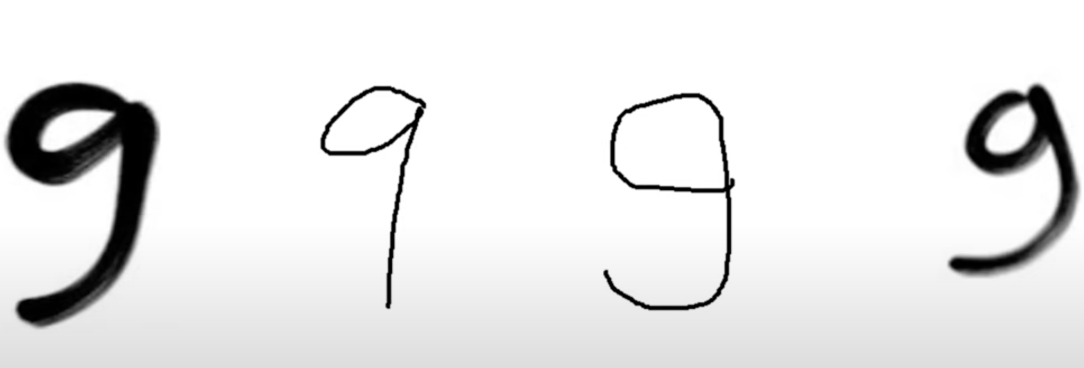
Necessity of Big Data for Deep Learning
Notes:
Neural networks are used to handle the variety in your inputs such that it can classify a variety of inputs in a generic way.

Slide 18
How much data needed to train one deep learning task?
A typical image classification problem could require tens of thousands of images or more

Slide 19
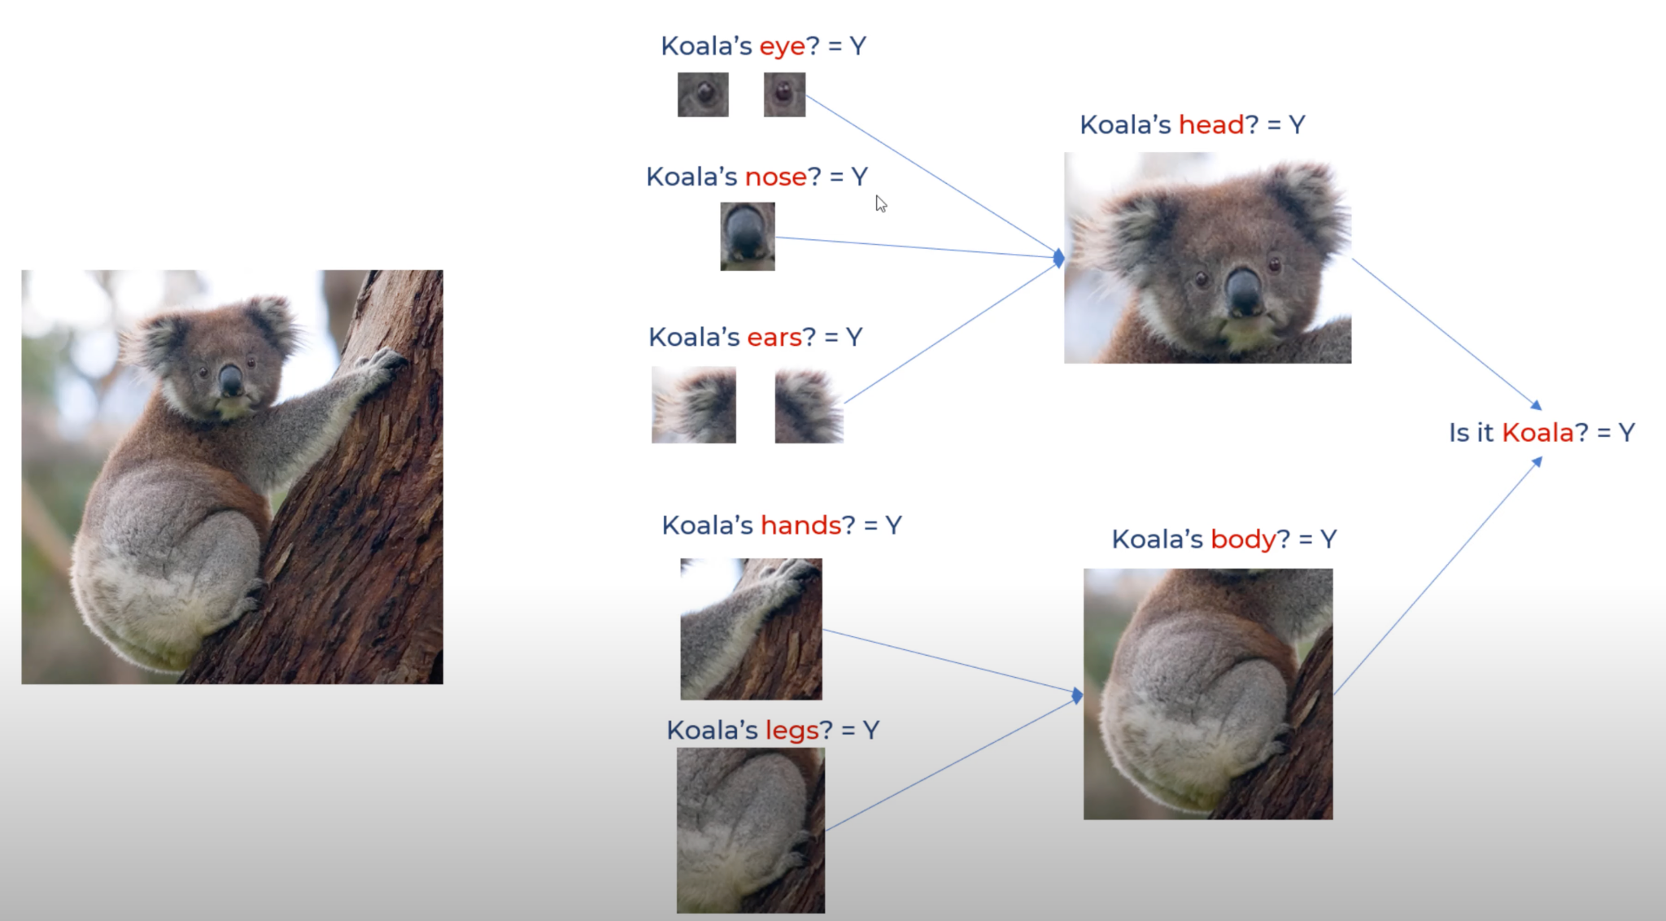
Which animal is this?

Slide 20
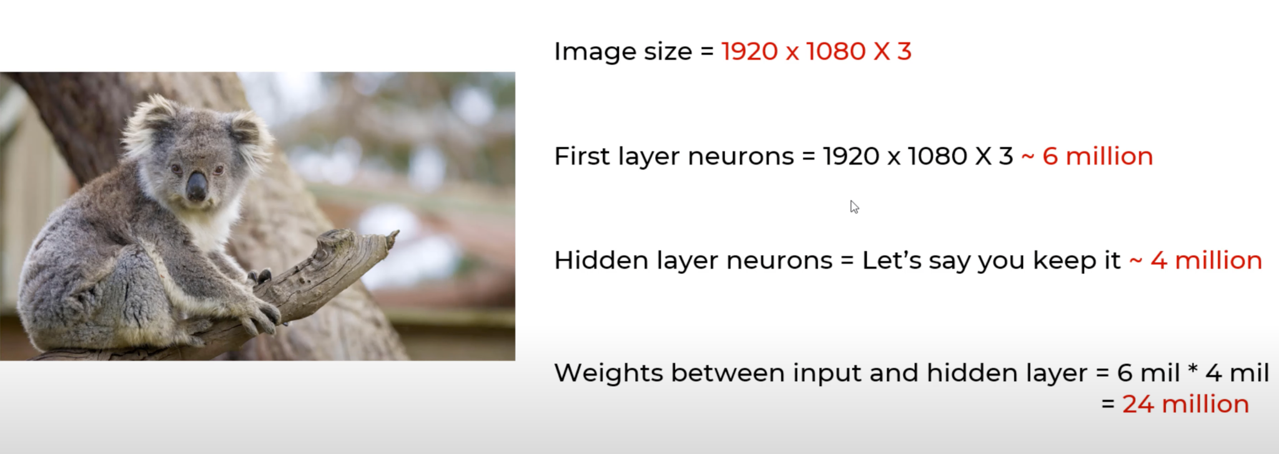
Thinking about Processing Power

Slide 21
Deep learning
Thinking about Processing Power:
Too much computation to do
Feature Engineering:
Sensitive to location of an object in an image

Slide 22
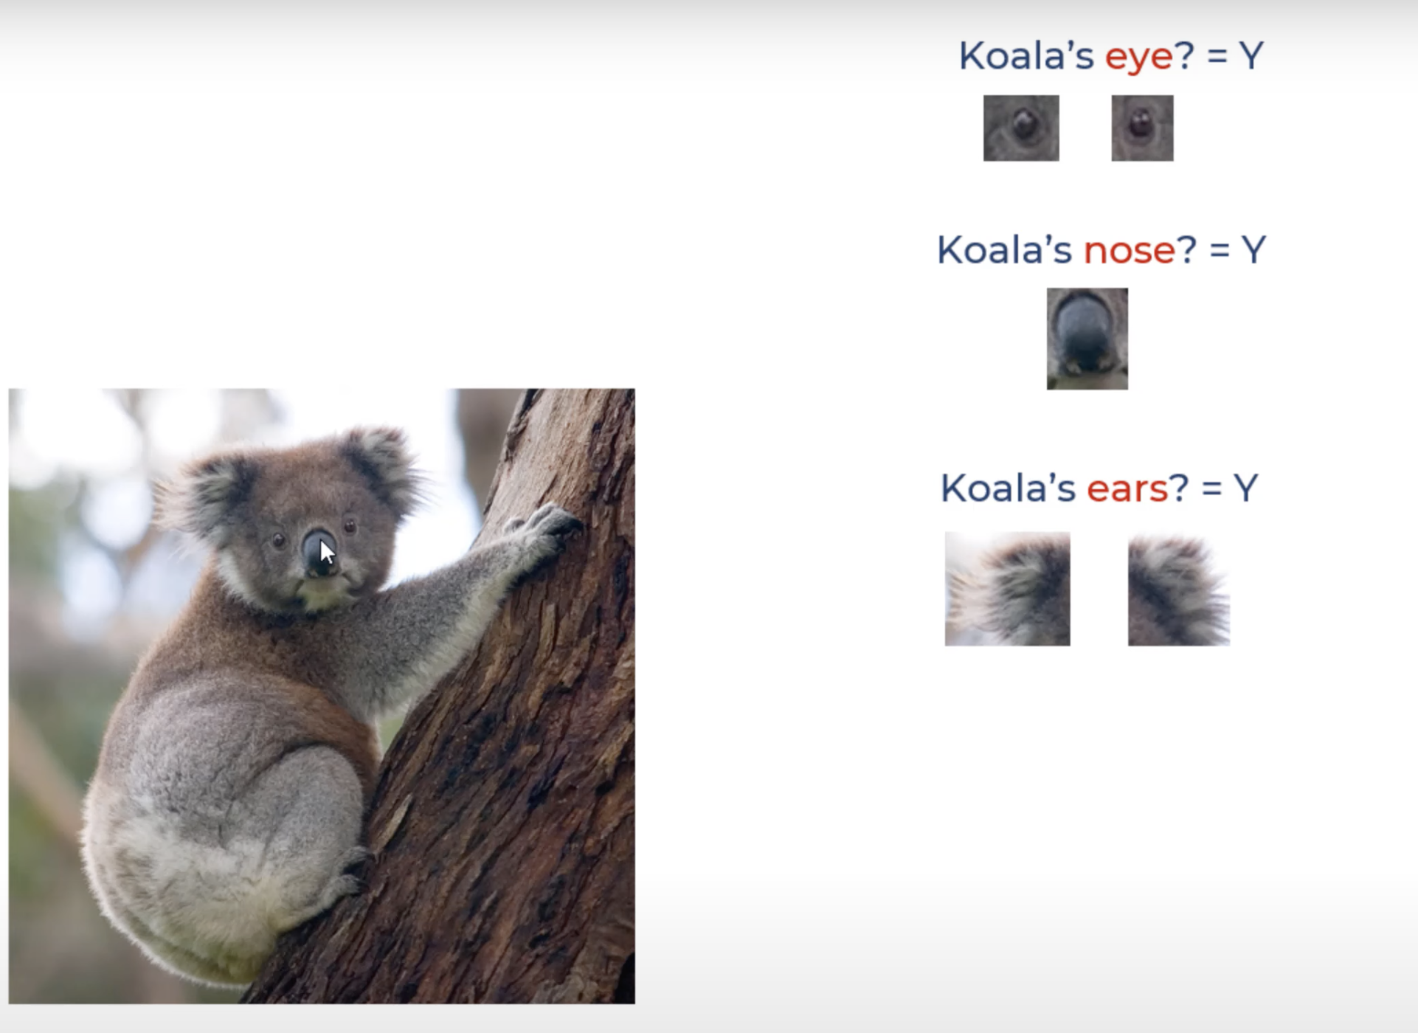
Feature Engineering

Slide 23
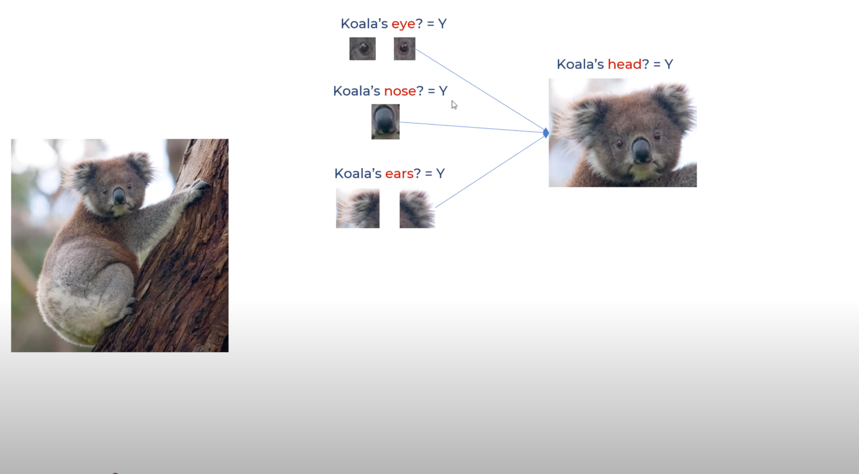
Forward one layer propagation

Slide 24
Full forward propagation

Slide 25
Deep neural network

Slide 26
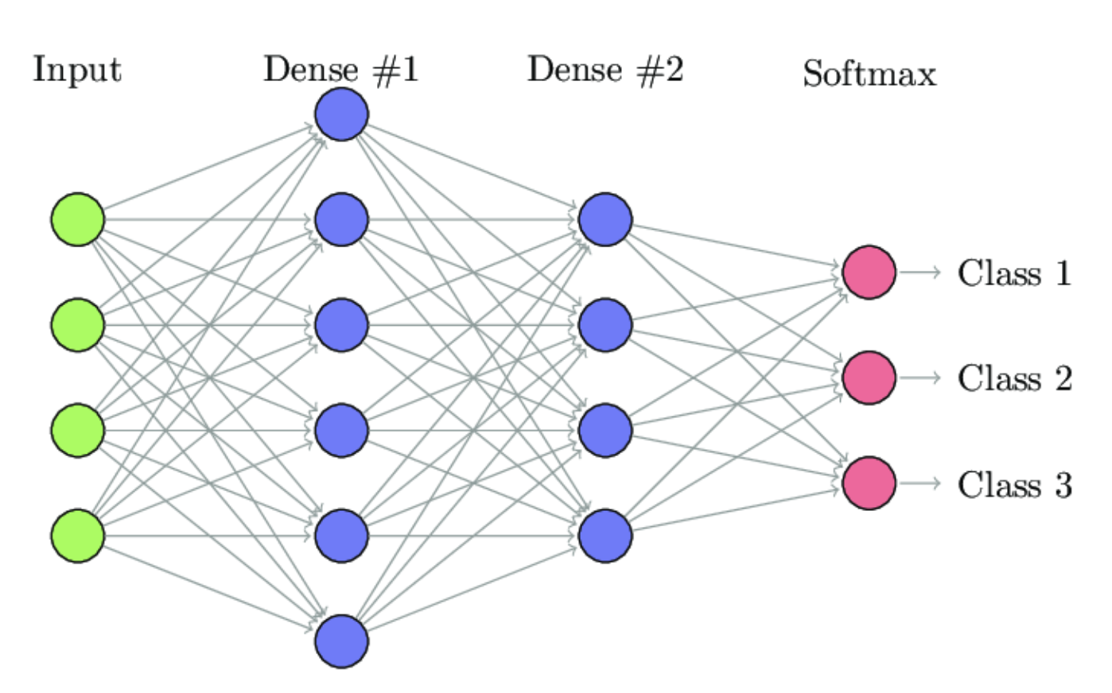
Neurons in each layer

Slide 27
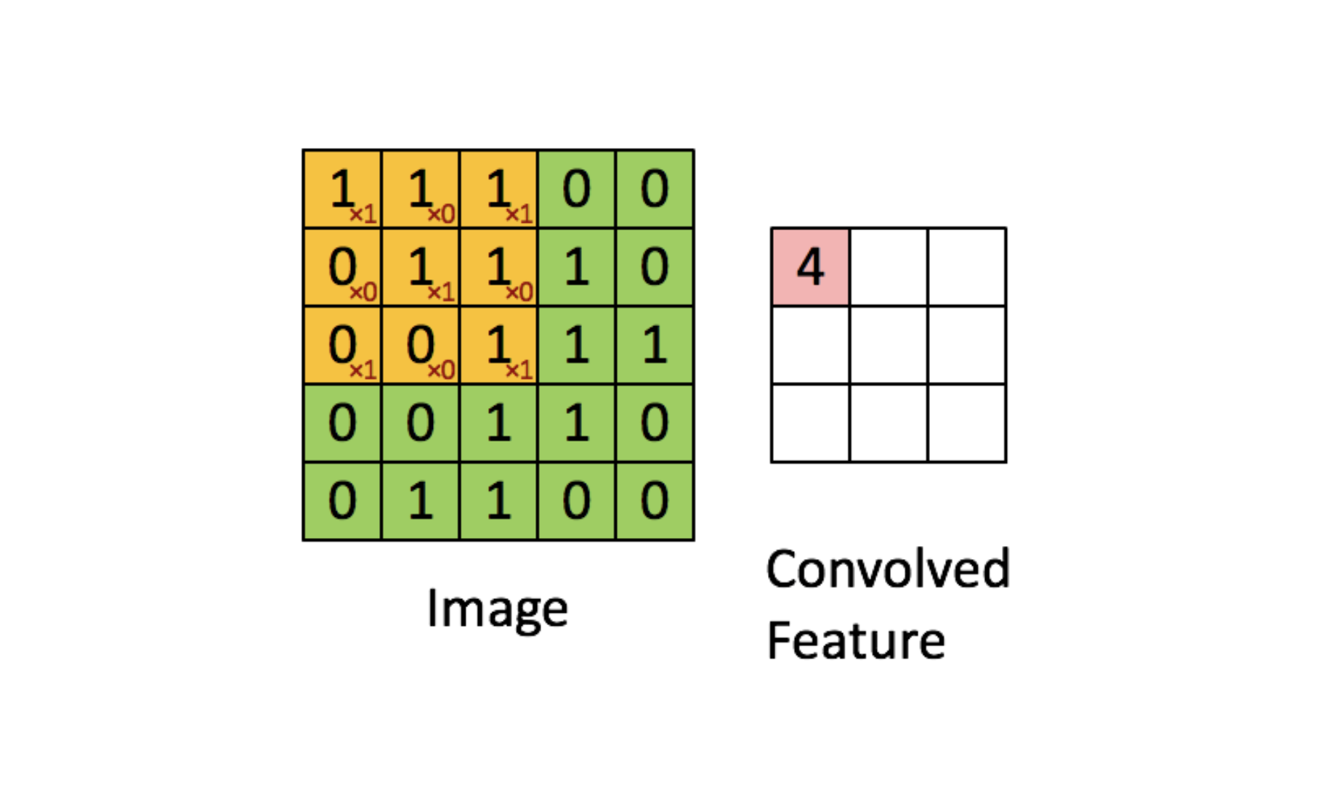
Calculation in a perceptron

Slide 28

Calculation in a perceptron

Slide 29
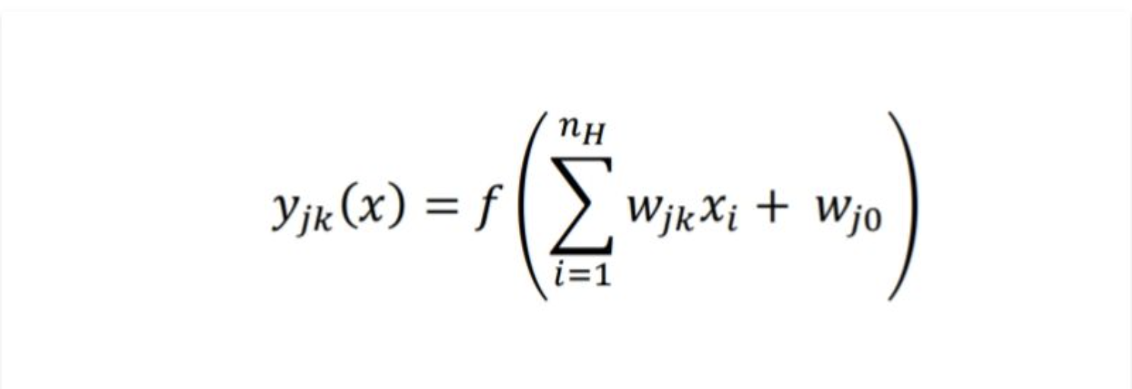
Equation on each neuron

Slide 30
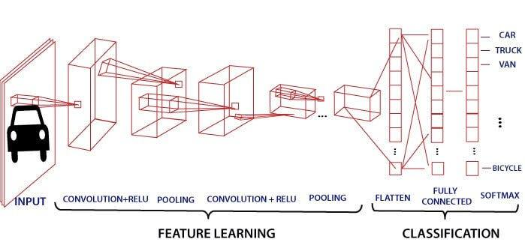
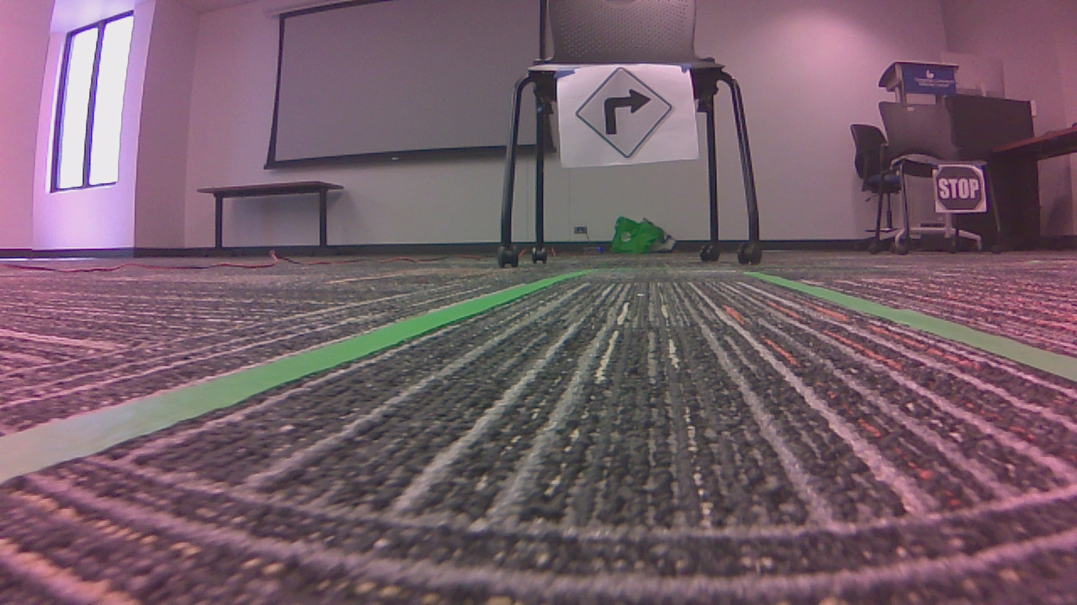
Neural Network for Traffic Sign Classification
Right
0.7
Left
0.15
Stop
0.1
Yield
0.05

Slide 31
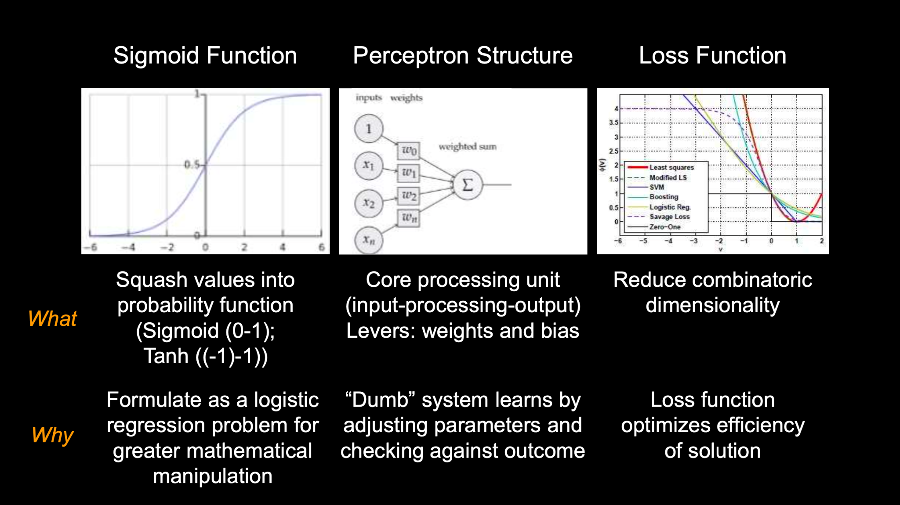
3 Key Technical Principles of Deep Learning

Slide 32
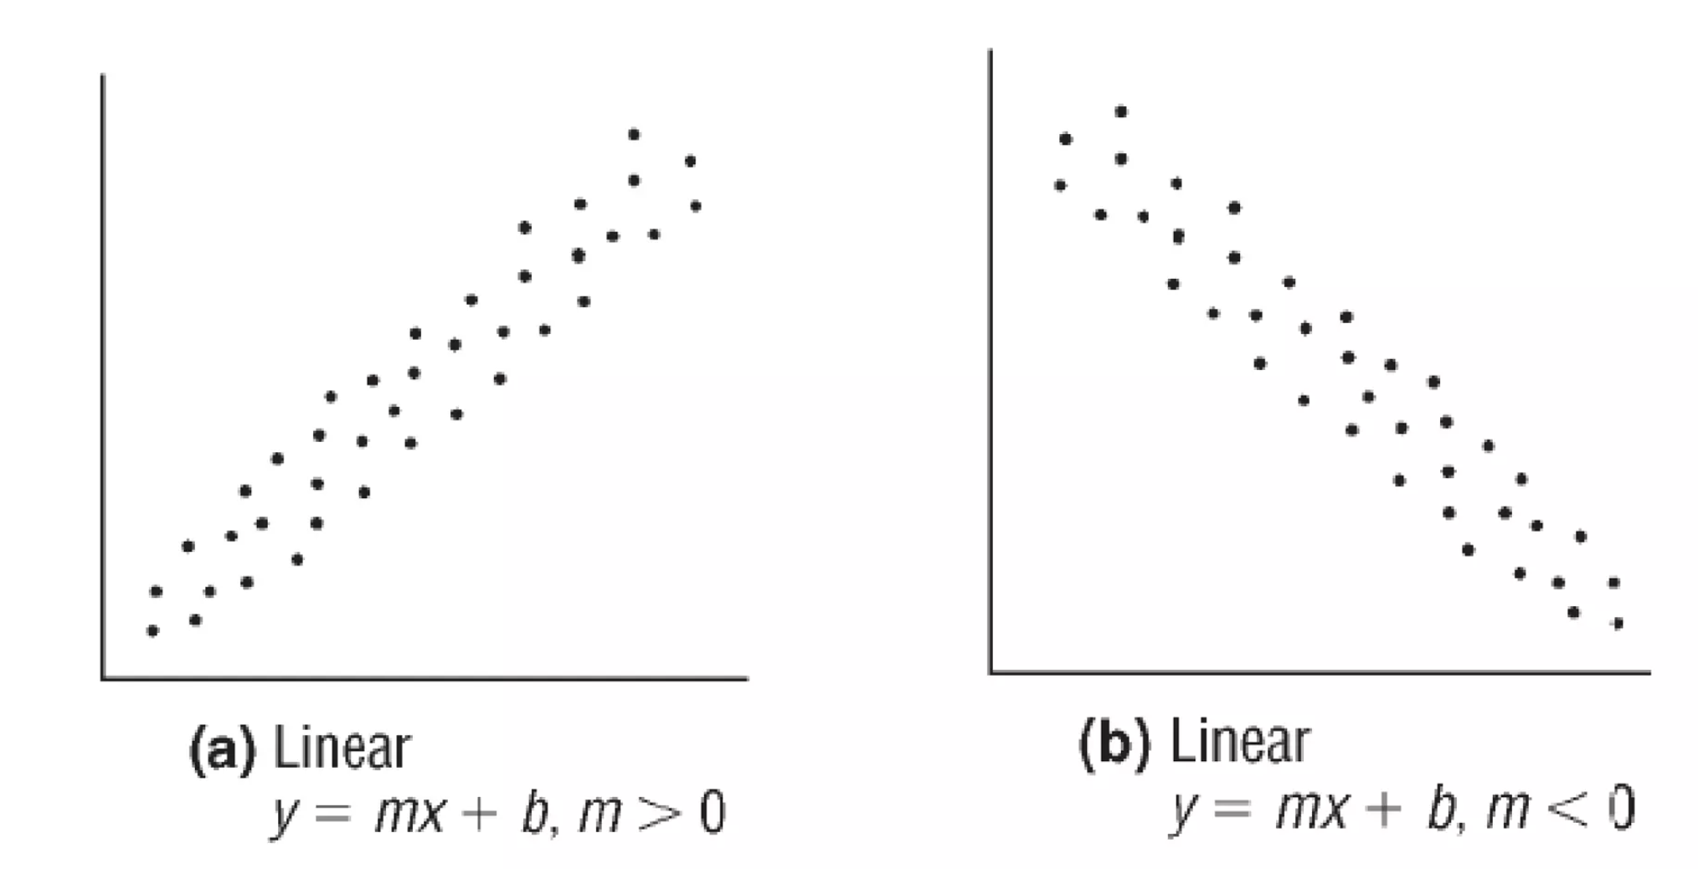
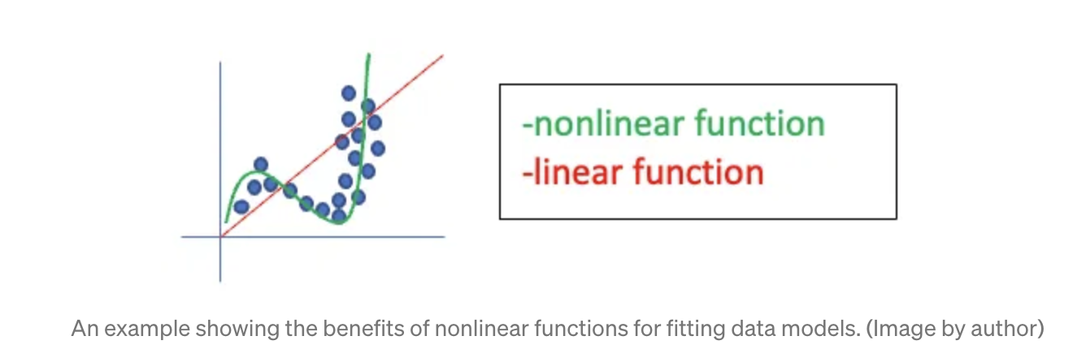
Activation Functions
Our equation: y=mx+b
Fig: Linear data
Fig: Non Linear data

Slide 33
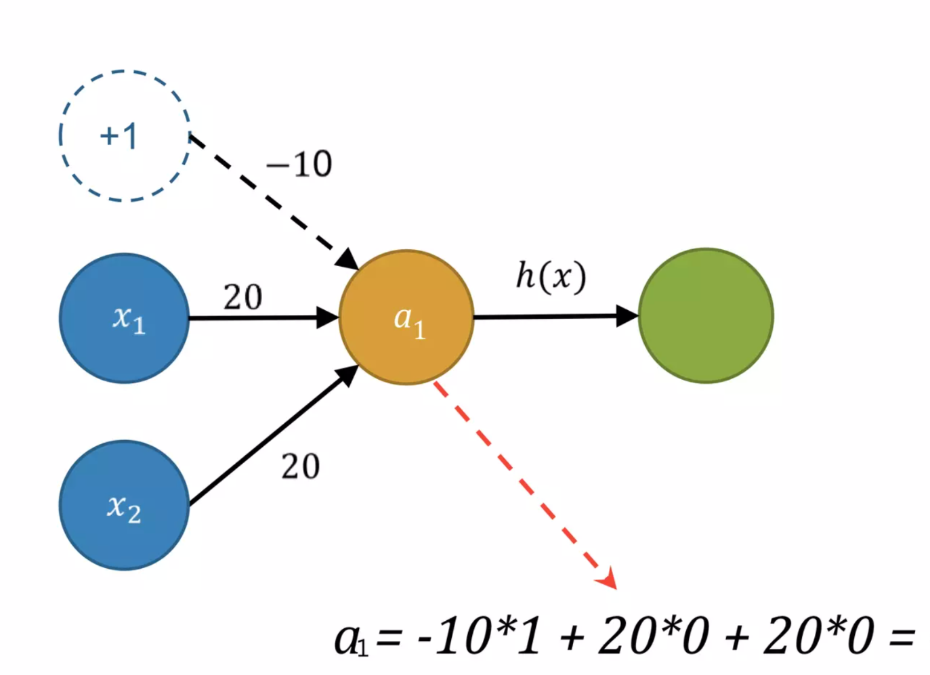
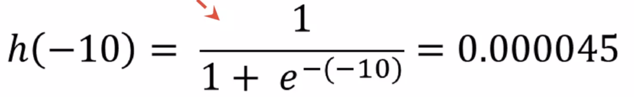
Calculations for perceptron and activation functions
-10

Slide 34
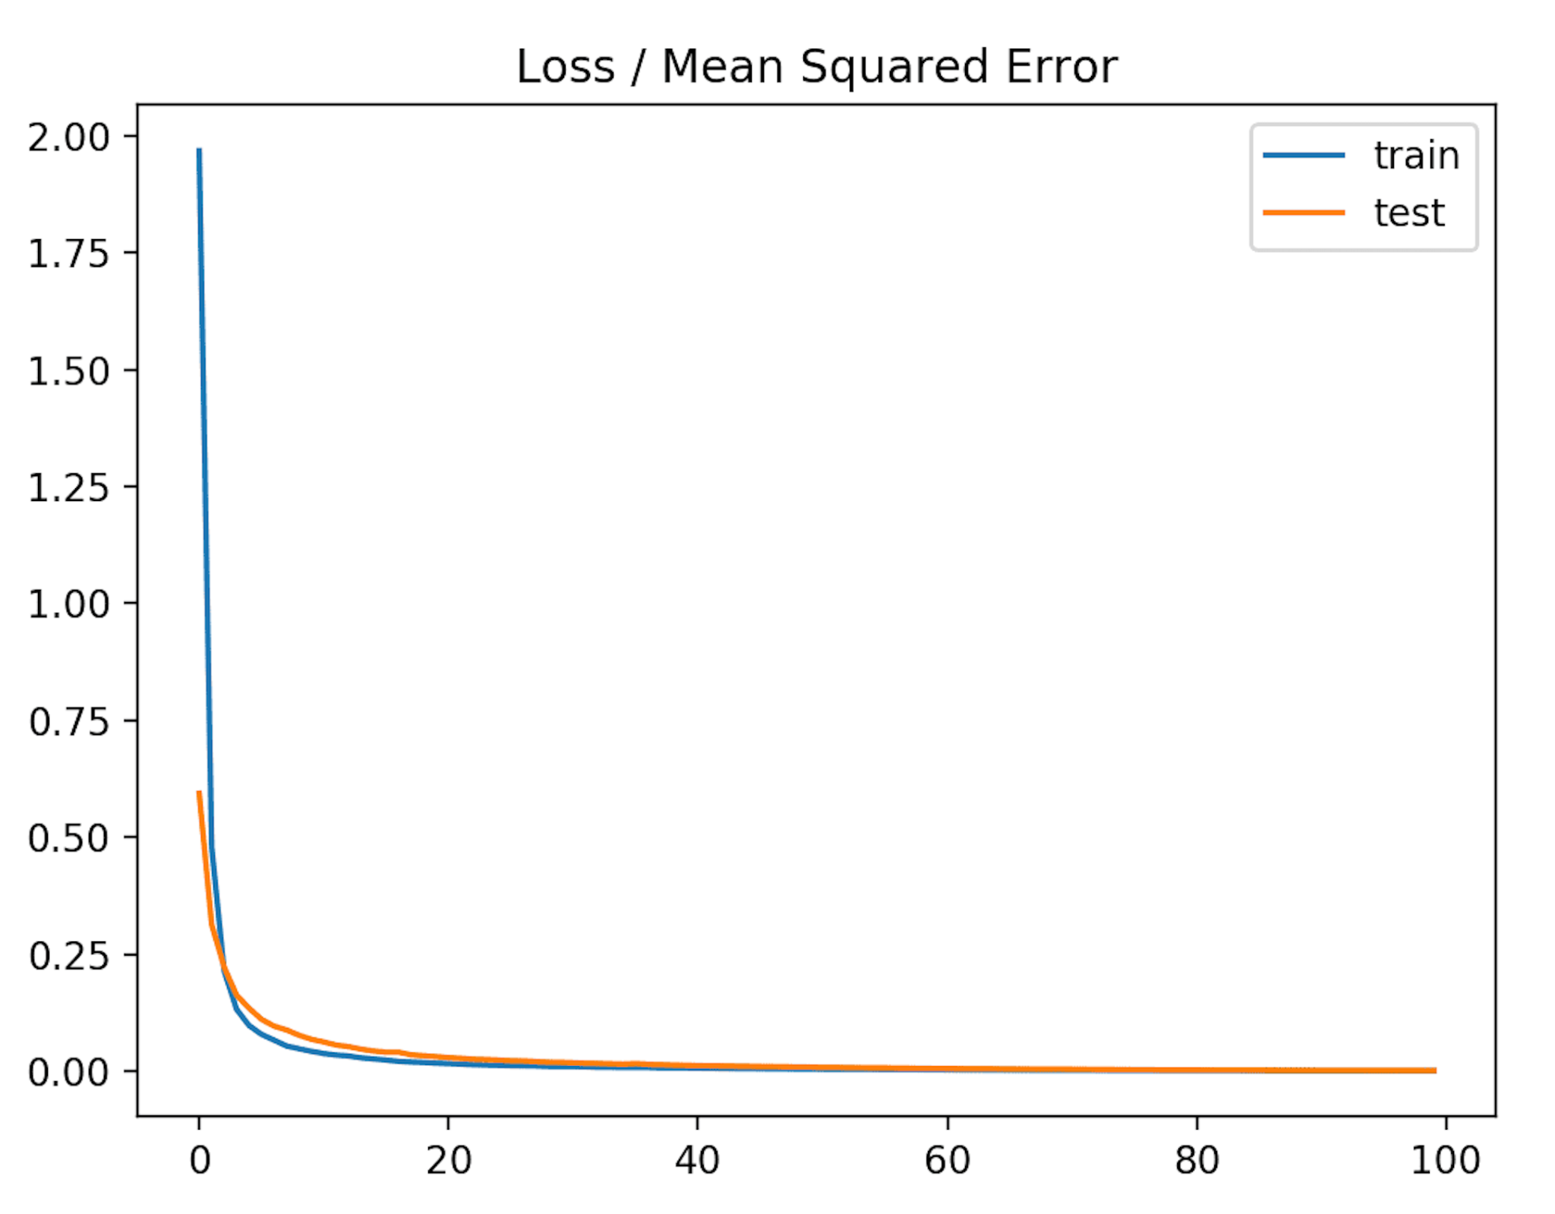
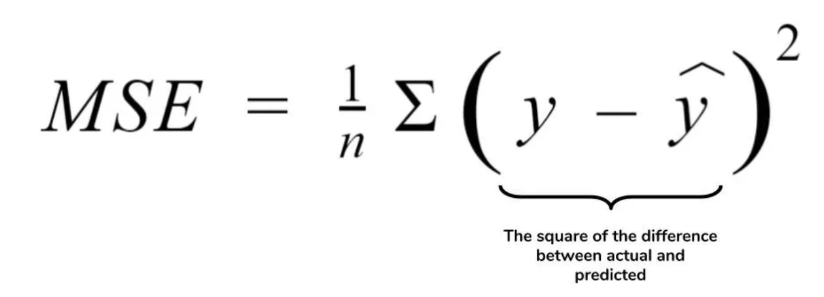
Loss functions

Slide 35
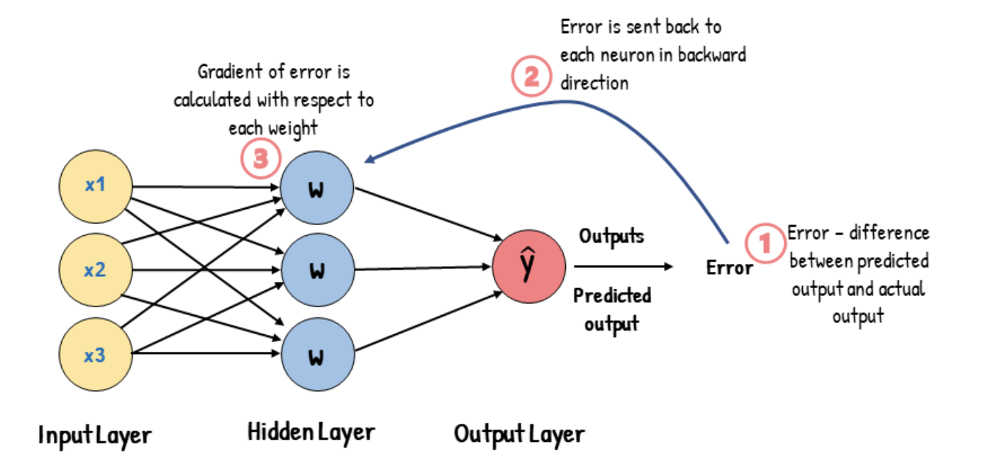
Backpropagation
https://youtu.be/XE3krf3CQls
Notes:
Neural network models are fitted using an optimization algorithm called stochastic gradient descent that incrementally changes the network weights to minimize a loss function, hopefully resulting in a set of weights for the mode that is capable of making useful predictions.

Slide 36
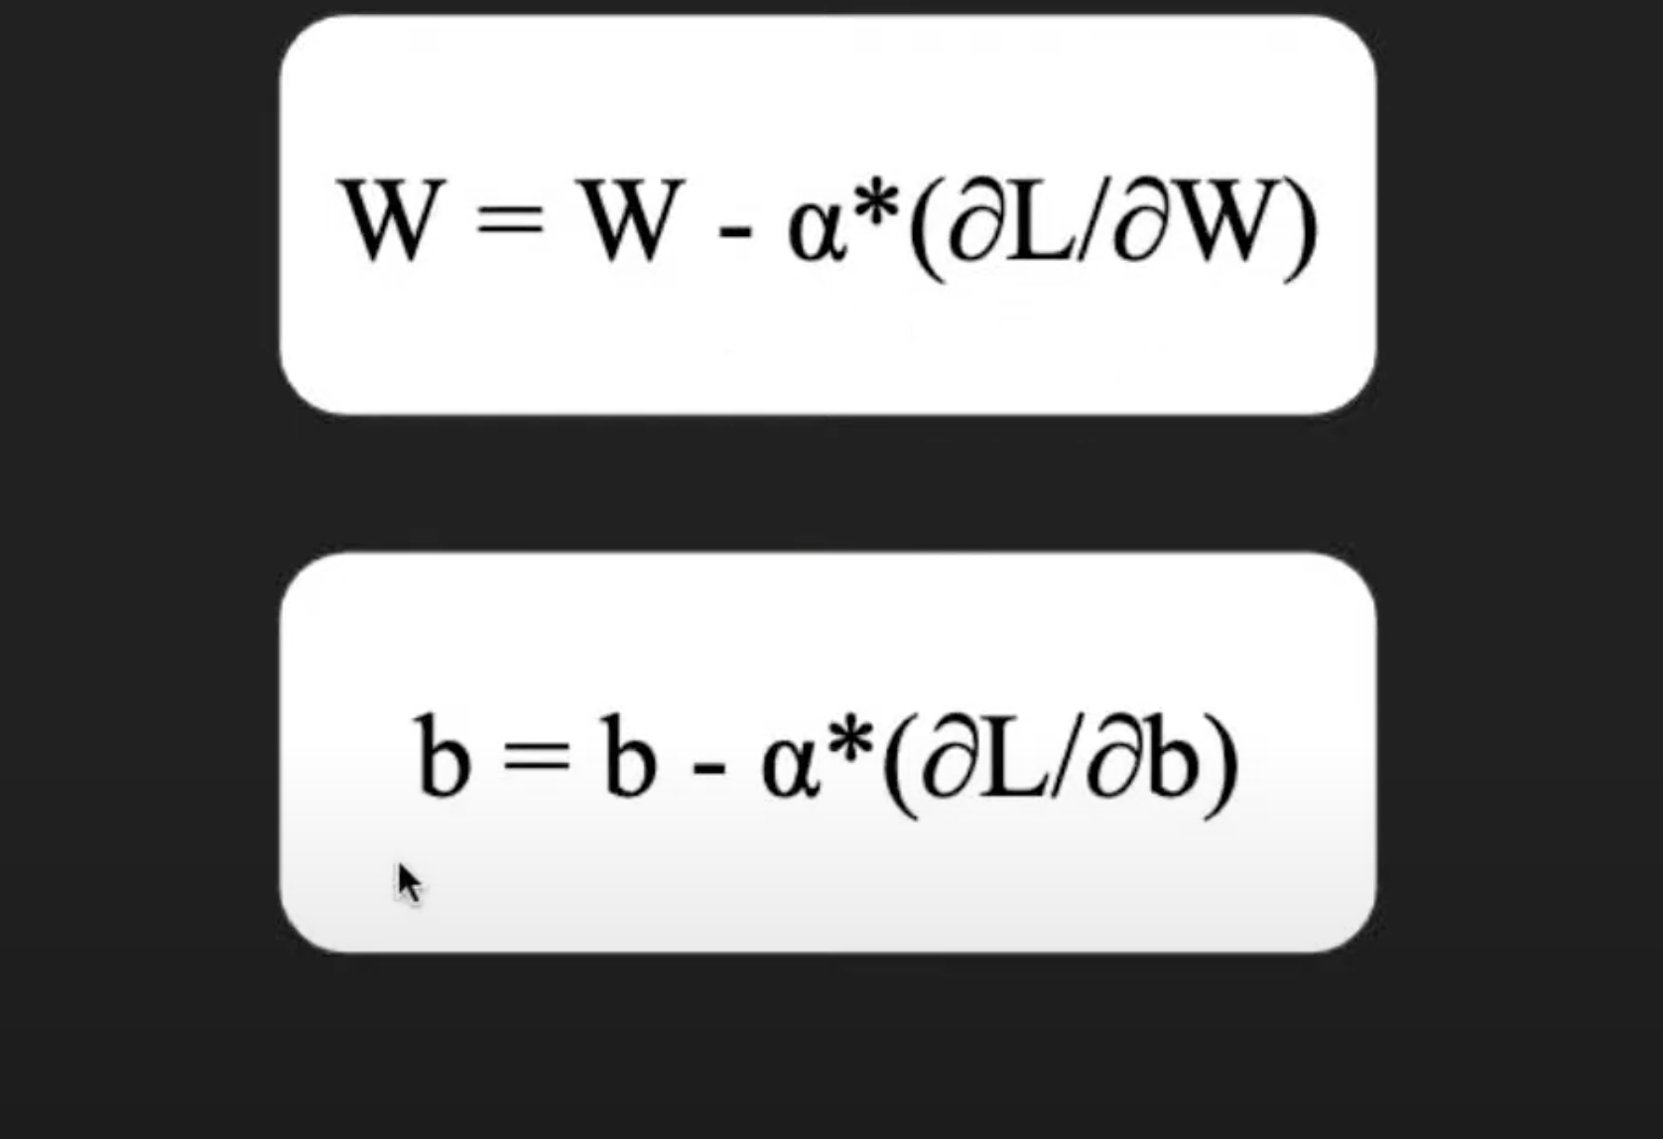
Back Propagation

Slide 37
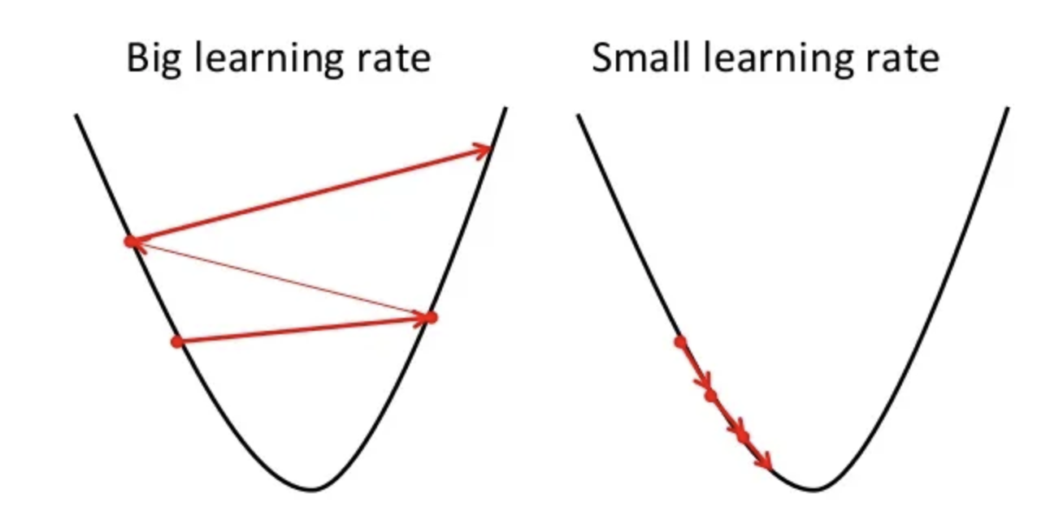
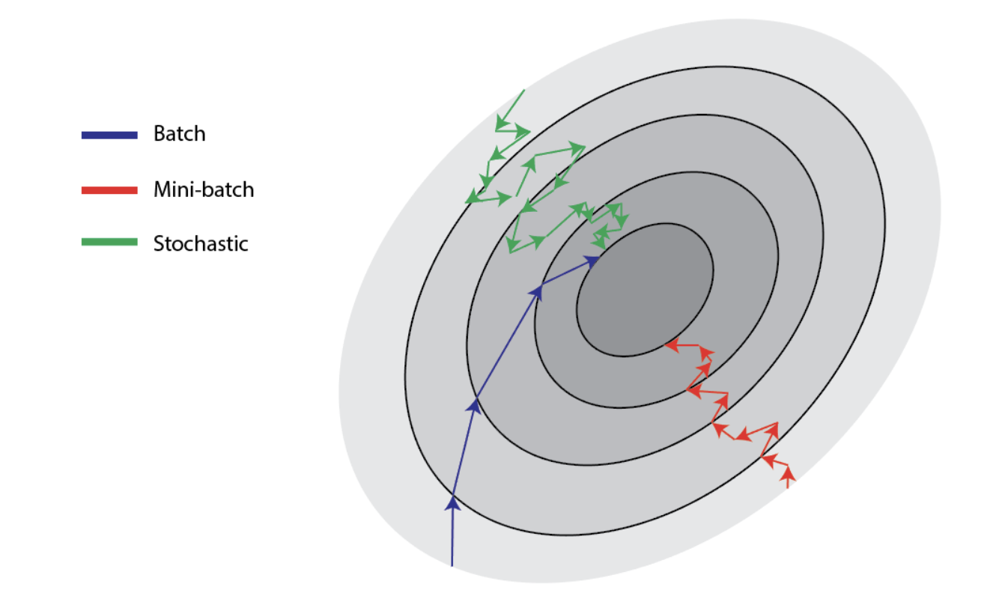
Hyperparameters to choose
Learning rates 2. Batch sizes

Slide 38
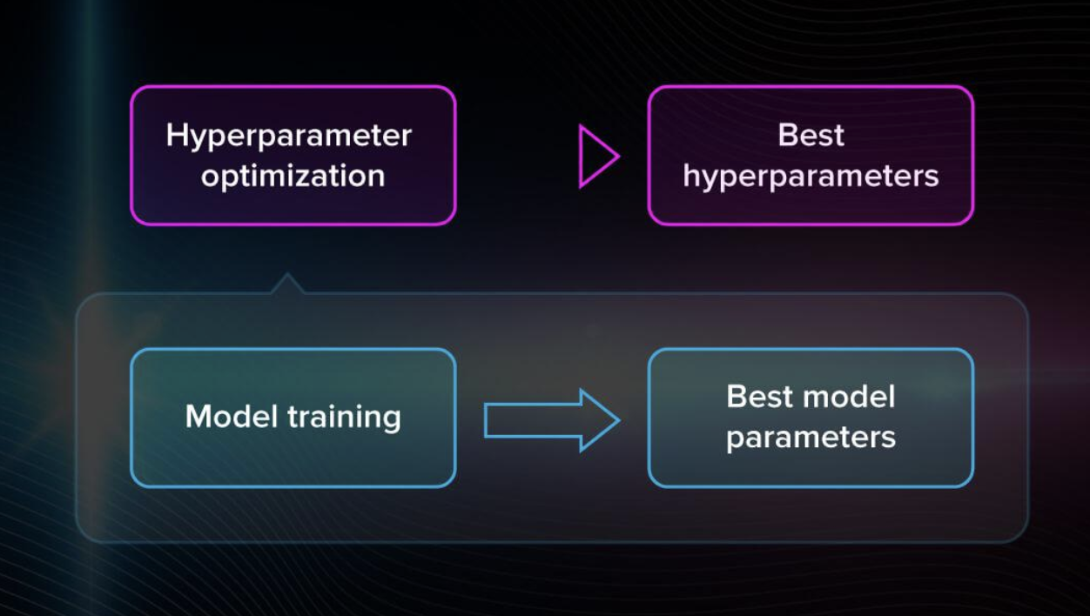
General Workflow

Slide 39
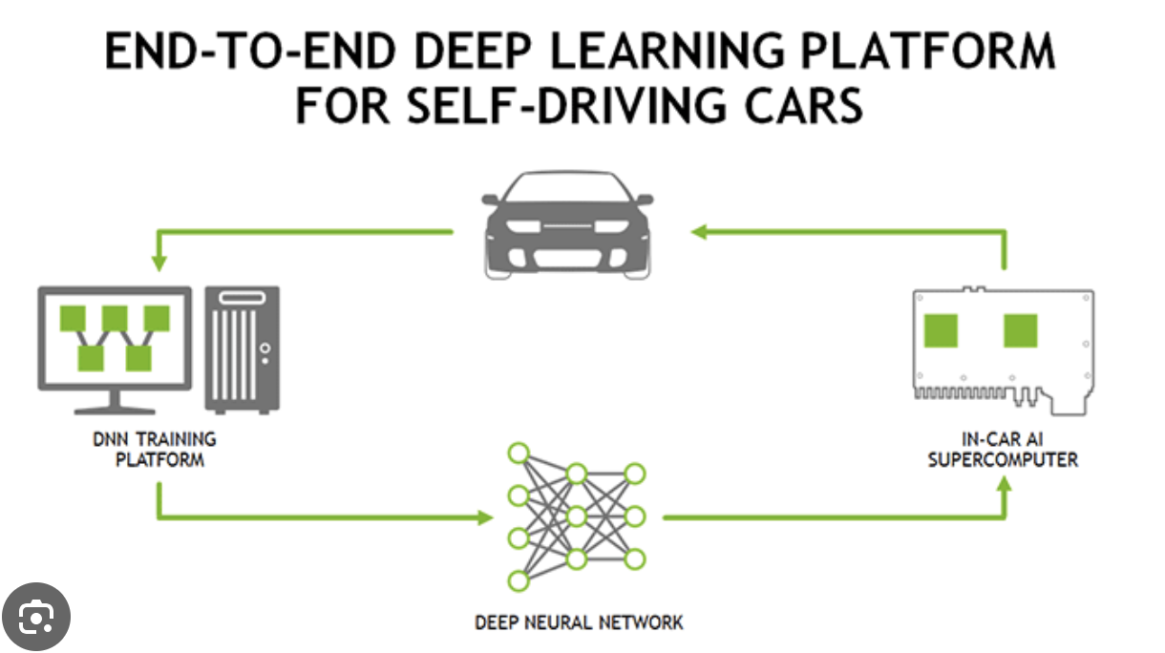
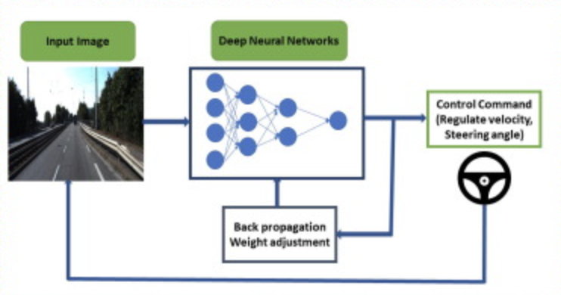
Self Driving Cars
Training
Evaluation

Slide 40
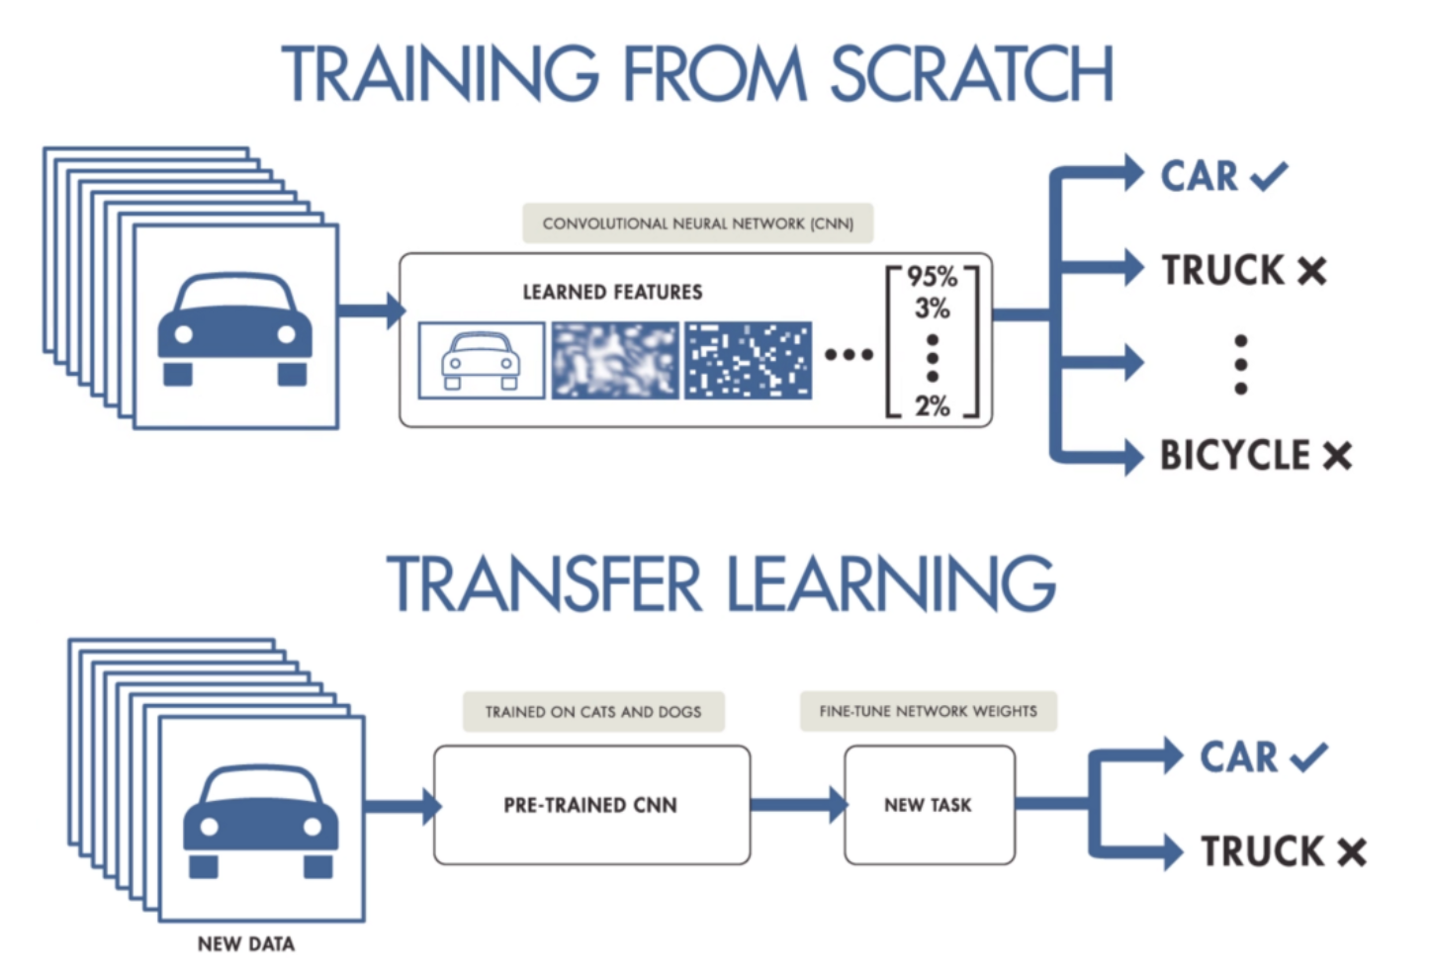
Transfer learning

Slide 41
Useful links:
Local minima and local maxima:
https://www.youtube.com/watch?v=WCq3sRzsJfs

